Slide 1

Advanced Java Programming
Topic: Java Server Pages (JSP)
By
Ravi Kant Sahu
Asst. Professor, LPU

Slide 2
Contents…
Introduction
Life cycle of a JSP Page
JSP Directory structure
JSP API
JSP Scripting elements
  scriptlet tag
  expression tag
  declaration tag
  JSP Implicit Objects
  JSP Action Tags
Ravi Kant Sahu, Asst. Professor @ Lovely Professional University, Punjab (India)

Slide 3
Java Server Pages
JavaServer Pages (JSP) is a Java technology for combining Java with HTML to provide dynamic content for Web pages.
A JSP page consists of HTML tags and JSP tags.
It is an advanced version of Servlet Technology.
JSP is first converted into servlet by JSP container before processing the client’s request.
Ravi Kant Sahu, Asst. Professor @ Lovely Professional University, Punjab (India)

Slide 4
JSP vs Servlet
JSP technology is the extension to Servlet technology with all the features of the Servlet. In addition to, it provides implicit objects, predefined tags, expression language and Custom tags, that makes JSP development easy.
JSP can be easily managed because we can easily separate our business logic with presentation logic. In Servlet, business logic is mixed with the presentation logic.
Fast Development: No need to recompile and redeploy.
Less code than Servlet

Slide 5
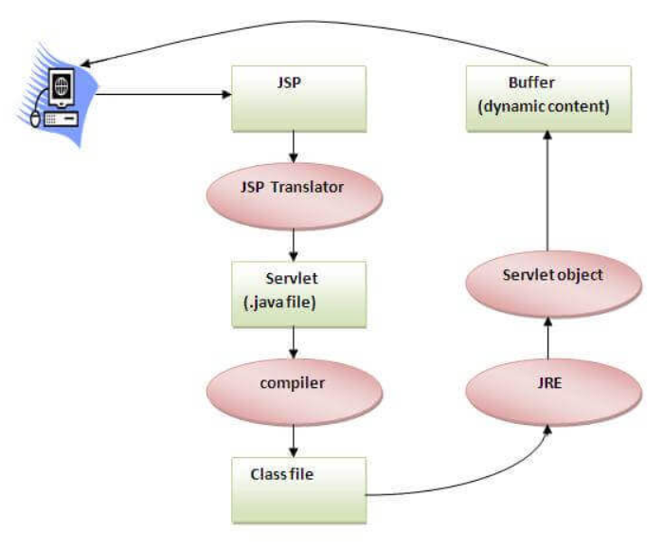
JSP Life Cycle

Slide 6
JSP Life Cycle
The JSP pages follow these phases:
Translation of JSP Page
Compilation of JSP Page
Class loading (the classloader loads class file)
Instantiation (Object of the Generated Servlet is created).
Initialization (the container invokes jspInit() method).
Request processing (the container invokes _jspService() method).
Destroy (the container invokes jspDestroy() method).
Ravi Kant Sahu, Asst. Professor @ Lovely Professional University, Punjab (India)

Slide 7
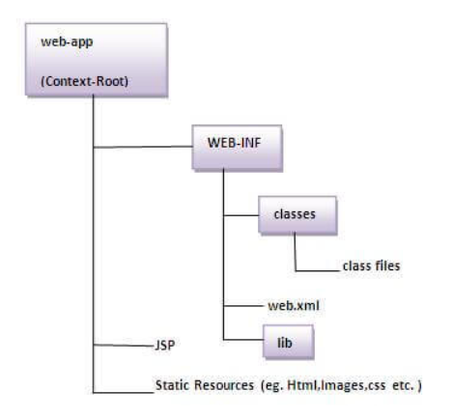
Directory Structure
Ravi Kant Sahu, Asst. Professor @ Lovely Professional University, Punjab (India)

Slide 8
Steps to run a JSP Page
Start the server
Put the JSP file in a folder and deploy on the server
Visit the browser using the URL http://localhost:portno/contextRoot/jspfile
Ravi Kant Sahu, Asst. Professor @ Lovely Professional University, Punjab (India)

Slide 9
JSP API
Ravi Kant Sahu, Asst. Professor @ Lovely Professional University, Punjab (India)

Slide 10
JSP API
The JSP API consists of two packages:
javax.servlet.jsp
javax.servlet.jsp.tagext
Ravi Kant Sahu, Asst. Professor @ Lovely Professional University, Punjab (India)

Slide 11
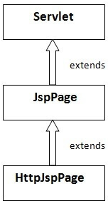
javax.servlet.jsp package
It has two interfaces:
JspPage
HttpJspPage
It has following classes:
JspWriter
PageContext
JspFactory
JspEngineInfo
JspException
JspError
Ravi Kant Sahu, Asst. Professor @ Lovely Professional University, Punjab (India)

Slide 12
JspPage Interface
According to the JSP specification, all the generated servlet classes must implement the JspPage interface.
It extends the Servlet interface. It provides two life cycle methods.
public void jspInit(): invoked only once during the life cycle of the JSP when JSP page is requested firstly. It is used to perform initialization.
public void jspDestroy(): It is invoked only once during the life cycle of the JSP before the JSP page is destroyed. It can be used to perform some clean up operation.
Ravi Kant Sahu, Asst. Professor @ Lovely Professional University, Punjab (India)

Slide 13
javax.servlet.jsp package
It has two interfaces:
JspPage
HttpJspPage
It has following classes:
JspWriter
PageContext
JspFactory
JspEngineInfo
JspException
JspError
Ravi Kant Sahu, Asst. Professor @ Lovely Professional University, Punjab (India)

Slide 14
HttpJspPage Interface
The HttpJspPage interface provides the one life cycle method of JSP.
It extends the JspPage interface.
public void _jspService(): It is invoked each time when request for the JSP page comes to the container.
It is used to process the request.
[The underscore _ signifies that we can’t override this method]
Ravi Kant Sahu, Asst. Professor @ Lovely Professional University, Punjab (India)

Slide 15
JSP Tags
Ravi Kant Sahu, Asst. Professor @ Lovely Professional University, Punjab (India)

Slide 16
JSP Declaration Tag
The JSP declaration tag is used to declare fields and methods.
The code written inside the jsp declaration tag is placed outside the service() method of auto generated servlet. So it doesn't get memory at each request.
Syntax:
<%! field or method declaration %>
Ravi Kant Sahu, Asst. Professor @ Lovely Professional University, Punjab (India)

Slide 17
Example
<html>
<body>
<%!
int result = 10;
int multiply (int a, int b){
return a*b;
}
%>
</body>
</html>
Ravi Kant Sahu, Asst. Professor @ Lovely Professional University, Punjab (India)

Slide 18
JSP Expression Tag
The code placed within JSP expression tag is written to the output stream of the response. So you need not write out.print() to write data.
It is mainly used to print the values of variable or method.
Syntax:
<%= statement %>
Ravi Kant Sahu, Asst. Professor @ Lovely Professional University, Punjab (India)

Slide 19
Example
<html>
<body>
<%= “This is My JSP Page” %>
</body>
</html>
Ravi Kant Sahu, Asst. Professor @ Lovely Professional University, Punjab (India)

Slide 20
JSP Scriptlet Tag
A scriptlet tag is used to execute java source code in JSP
Syntax:
<% java source code %>
Ravi Kant Sahu, Asst. Professor @ Lovely Professional University, Punjab (India)

Slide 21
Example
<html>
<body>
<% String name=request.getParameter("uname");
out.print("welcome "+name);
%>
</body>
</html>
Ravi Kant Sahu, Asst. Professor @ Lovely Professional University, Punjab (India)

Slide 22
JSP Implicit Objects
Ravi Kant Sahu, Asst. Professor @ Lovely Professional University, Punjab (India)

Slide 23
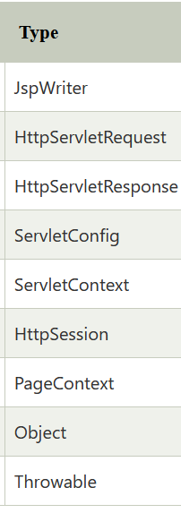
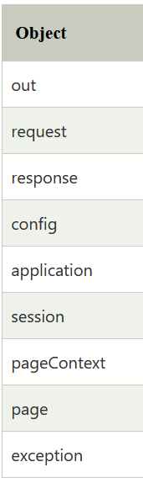
Implicit Objects
There are 9 JSP implicit objects. These objects are created by the web container that are available to all the JSP pages.
Ravi Kant Sahu, Asst. Professor @ Lovely Professional University, Punjab (India)

Slide 24
JspWriter
abstract void clear()
abstract void close()
abstract void flush()
abstract void print(String s)
abstract void println(Object x)
Ravi Kant Sahu, Asst. Professor @ Lovely Professional University, Punjab (India)

Slide 25
ServletRequest
Object getAttribute(String name)
Enumeration getAttributeName()
ServletInputStream getInputStream()
String getParameter(String name)
String getLocalAddr()
Ravi Kant Sahu, Asst. Professor @ Lovely Professional University, Punjab (India)

Slide 26
ServletRequest
Enumeration getParameterNames()
ServletContext getServletContext()
void removeAttribute(String name)
void setAttribute(String name, Object o)
RequestDispatcher getRequestDispatcher(String arg0)
Ravi Kant Sahu, Asst. Professor @ Lovely Professional University, Punjab (India)

Slide 27
HttpServletRequest interface
Cookies getCookies()
String getQueryString()
HttpSession getSession()
String getMethod()
Ravi Kant Sahu, Asst. Professor @ Lovely Professional University, Punjab (India)

Slide 28
ServletResponse
PrintWriter getWriter()
Ravi Kant Sahu, Asst. Professor @ Lovely Professional University, Punjab (India)

Slide 29
HttpServletResponse Interface
void addCookie(Cookie cookie)
String getHeader(String name)
void setHeader(String name, String value)
void sendRedirect(String arg0) throws IOException
Ravi Kant Sahu, Asst. Professor @ Lovely Professional University, Punjab (India)

Slide 30
HttpSession
public void setAttribute(String name, Object value)
public Object getAttribute(String name)
public Enumeration getAttributeNames()
public void removeAttribute(String name)
void setMaxInactiveInterval(int interval)
Ravi Kant Sahu, Asst. Professor @ Lovely Professional University, Punjab (India)

Slide 31
RequestDispatcher Interface
The RequestDispatcher Interface is used for dispatching the request to a resource
public void forward(ServletRequest request,ServletResponse response)throws ServletException,java.io.IOException
public void include(ServletRequest request,ServletResponse response)throws ServletException,java.io.IOException
Ravi Kant Sahu, Asst. Professor @ Lovely Professional University, Punjab (India)

Slide 32
sendRedirect() in Servlet
sendRedirect() method redirects the response to another resource.
Ravi Kant Sahu, Asst. Professor @ Lovely Professional University, Punjab (India)

Slide 33
Servlet: sendRedirect() and Request Dispatcher
sendRedirect() makes the client(browser) create a new request to get to the resource, the user can see the new URL
request dispatch get the resource in same request and URL does not changes.
Ravi Kant Sahu, Asst. Professor @ Lovely Professional University, Punjab (India)

Slide 34
JSP Directives
Ravi Kant Sahu, Asst. Professor @ Lovely Professional University, Punjab (India)

Slide 35
JSP Directives
The jsp directives are messages that tells the web container how to translate a JSP page into the corresponding servlet.
It is used to specify core functionalities for our JSP files.
There are three types of directives:
  page directive
  include directive
  taglib directive
Ravi Kant Sahu, Asst. Professor @ Lovely Professional University, Punjab (India)

Slide 36
JSP page directive
The page directive defines attributes that apply to an entire JSP page.
import
contentType
extends: defines the parent class that will be inherited by the generated servlet.
Info
buffer
session
pageEncoding
errorPage
isErrorPage
Ravi Kant Sahu, Asst. Professor @ Lovely Professional University, Punjab (India)

Slide 37
import Example
<html>
<body>
<%@ page import="java.util.Date" %>
Today is: <%= new Date() %>
</body>
</html>
Ravi Kant Sahu, Asst. Professor @ Lovely Professional University, Punjab (India)

Slide 38
contentType Example
contentType attribute defines the MIME(Multipurpose Internet Mail Extension) type of the HTTP response.
The default value is "text/html;charset=ISO-8859-1".
<html>
<body>
<%@ page contentType=application/msword %>
<%@ page import="java.util.Date" %>
Today is: <%= new Date() %>
</body>
</html>
Ravi Kant Sahu, Asst. Professor @ Lovely Professional University, Punjab (India)

Slide 39
info Example
The web container will create a method getServletInfo() in the resulting servlet.
<html>
<body>
<%@ page info=“This is Advanced Java Programming" %>
<%@ page import="java.util.Date" %>
Today is: <%= new Date() %>
</body>
</html>
Ravi Kant Sahu, Asst. Professor @ Lovely Professional University, Punjab (India)

Slide 40
buffer Example
The buffer attribute sets the buffer size in kilobytes to handle output generated by the JSP page.The default size of the buffer is 8Kb.
<html>
<body>
<%@ page buffer="16kb" %>
<%@ page import="java.util.Date" %>
Today is: <%= new Date() %>
</body>
</html>
Ravi Kant Sahu, Asst. Professor @ Lovely Professional University, Punjab (India)

Slide 41
errorPage Example
<html>
<body>
<%@ page errorPage="myerrorpage.jsp" %>
<%= 100/0 %>
</body>
</html>
Ravi Kant Sahu, Asst. Professor @ Lovely Professional University, Punjab (India)

Slide 42
isErrorPage Example
<html>
<body>
<%@ page isErrorPage="true" %>
Sorry an exception occured!<br/>
The exception is: <%= exception %>
</body>
</html>
Ravi Kant Sahu, Asst. Professor @ Lovely Professional University, Punjab (India)

Slide 43
JSP Include Directive
The include directive is used to include the contents of any resource it may be jsp file, html file or text file.
The include directive includes the original content of the included resource at page translation time.
It ensures Code Reusability.
Ravi Kant Sahu, Asst. Professor @ Lovely Professional University, Punjab (India)

Slide 44
Include Directive Example
<html>
<body>
<%@ include file="header.html" %>
Today is: <%= java.util.Calendar.getInstance().getTime() %>
</body>
</html>
Ravi Kant Sahu, Asst. Professor @ Lovely Professional University, Punjab (India)

Slide 45
JSP Taglib Directive
The JSP taglib directive is used to define a tag library that defines many tags.
We use the TLD (Tag Library Descriptor) file to define the tags.
Syntax:
<%@ taglib uri= “uri_of_tag_library”
prefix= “prefix_of_tag_library” %>
Ravi Kant Sahu, Asst. Professor @ Lovely Professional University, Punjab (India)

Slide 46
Exception Handling
Ravi Kant Sahu, Asst. Professor @ Lovely Professional University, Punjab (India)

Slide 47
Exception handling in JSP
Error can be handle by errorPage and isErrorPage attributes of page directive.
<html>
<body>
<%@ page errorPage="myerrorpage.jsp" %>
<%= 100/0 %>
</body>
</html>
Ravi Kant Sahu, Asst. Professor @ Lovely Professional University, Punjab (India)

Slide 48
Exception handling in JSP
In JSP, exception is an implicit object of Throwable. This object can be used to print the exception. But it can only be used in error pages.
<%@ page isErrorPage="true" %>
<html>
<body>
Sorry following exception occurred:<%= exception %>
</body>
</html>
Ravi Kant Sahu, Asst. Professor @ Lovely Professional University, Punjab (India)

Slide 49
Session Tracking
Ravi Kant Sahu, Asst. Professor @ Lovely Professional University, Punjab (India)

Slide 50
Session Tracking
Session simply means a particular interval of time.
Session Tracking (Session Management) is a way to maintain state (data) of an user.
Http protocol is a stateless so we need to maintain state using session tracking techniques. Each time user requests to the server, server treats the request as the new request. So we need to maintain the state of an user to recognize to particular user.
Ravi Kant Sahu, Asst. Professor @ Lovely Professional University, Punjab (India)

Slide 51
Session Tracking using HttpSession
The HttpServletRequest interface provides two methods to get the object of HttpSession:
public HttpSession getSession(): Returns the current session associated with this request, or if the request does not have a session, creates one.
public HttpSession getSession(boolean create): Returns the current HttpSession associated with this request or, if there is no current session and create is true, returns a new session.
Ravi Kant Sahu, Asst. Professor @ Lovely Professional University, Punjab (India)

Slide 52
Methods of HttpSession
public String getId(): Returns a string containing the unique identifier value.
public long getCreationTime(): Returns the time when this session was created, measured in milliseconds since midnight January 1, 1970 GMT.
public long getLastAccessedTime(): Returns the last time the client sent a request associated with this session, as the number of milliseconds since midnight January 1, 1970 GMT.
public void invalidate(): Invalidates this session then unbinds any objects bound to it.
Ravi Kant Sahu, Asst. Professor @ Lovely Professional University, Punjab (India)

Slide 53
MVC in JSP
MVC stands for Model View and Controller. It is a design pattern that separates the business logic, presentation logic and data.
Controller acts as an interface between View and Model. Controller intercepts all the incoming requests.
Model represents the state of the application i.e. data. It can also have business logic.
View represents the presentaion i.e. UI(User Interface).
Ravi Kant Sahu, Asst. Professor @ Lovely Professional University, Punjab (India)

Slide 54
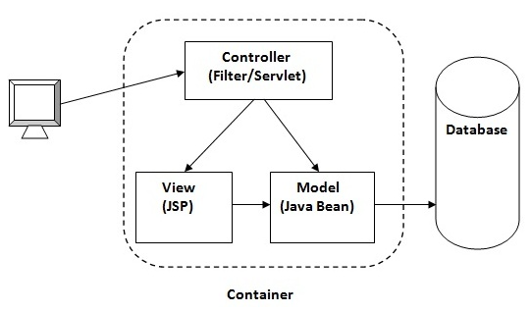
MVC in JSP
Ravi Kant Sahu, Asst. Professor @ Lovely Professional University, Punjab (India)

Slide 55
Advantage of MVC
Navigation Control is centralized
Easy to maintain the large application
Ravi Kant Sahu, Asst. Professor @ Lovely Professional University, Punjab (India)

Slide 56


